Slide 1
Chapter
3
Production of X-Rays
March 2020
Ui-Jung Hwang, PhD, KBMP, DABR
Chungnam National University Hospital

Slide 2
X-ray tube
Basic x-ray circuit
Voltage rectification
Physics of x-ray production
X-ray energy spectra
Operating characteristics

Slide 3
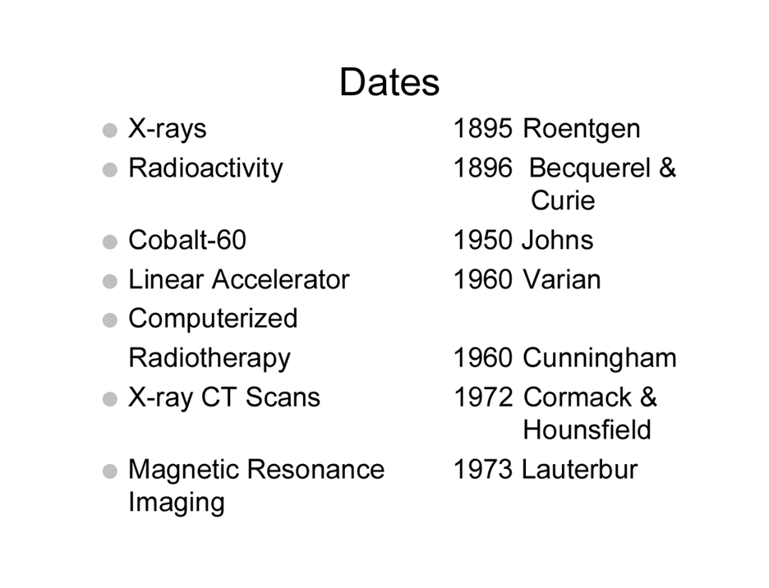

Slide 4
X-ray Production
Excitation
Ionization
Bremsstrahlung

Slide 5
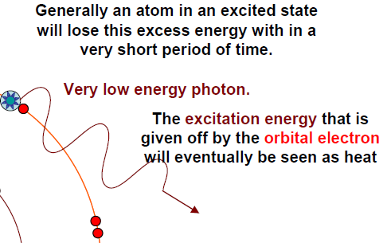
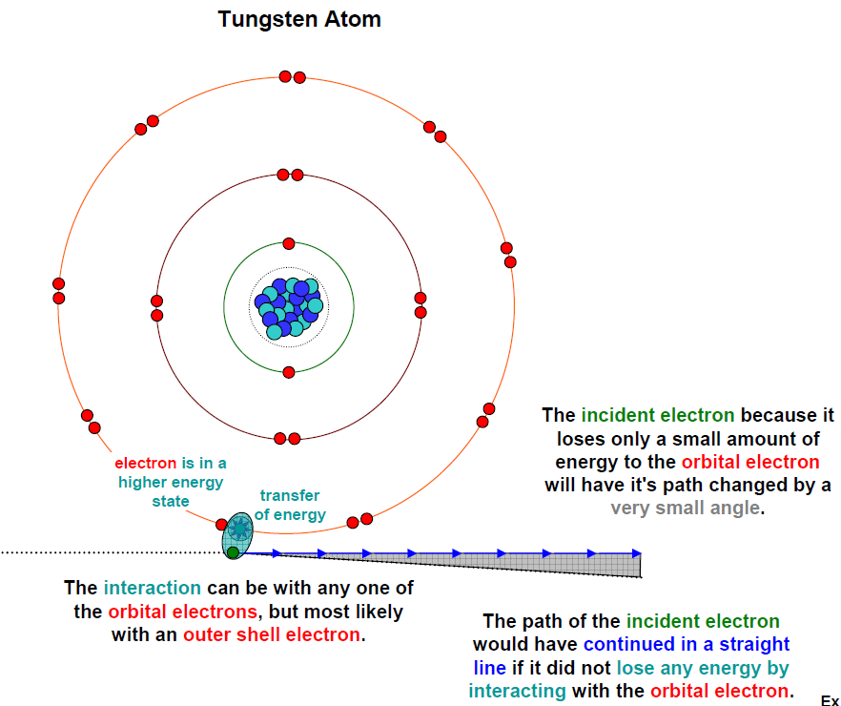
Excitation

Slide 6
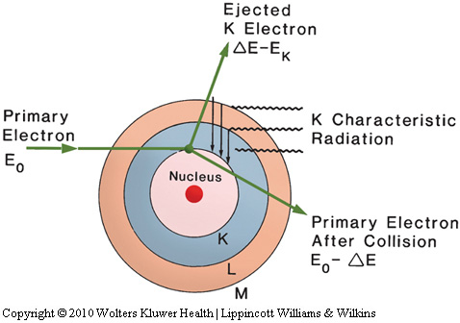
2. Ionization (Characteristic X-ray)
interact with atoms of the target by ejecting an orbital electron, leaving the atom ionized
emitted at discrete energies

Slide 7
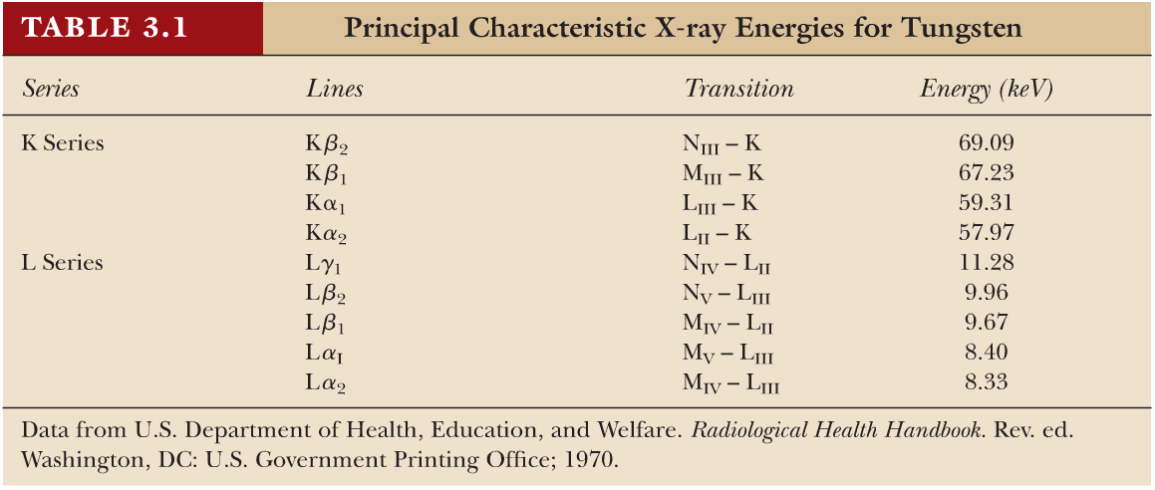
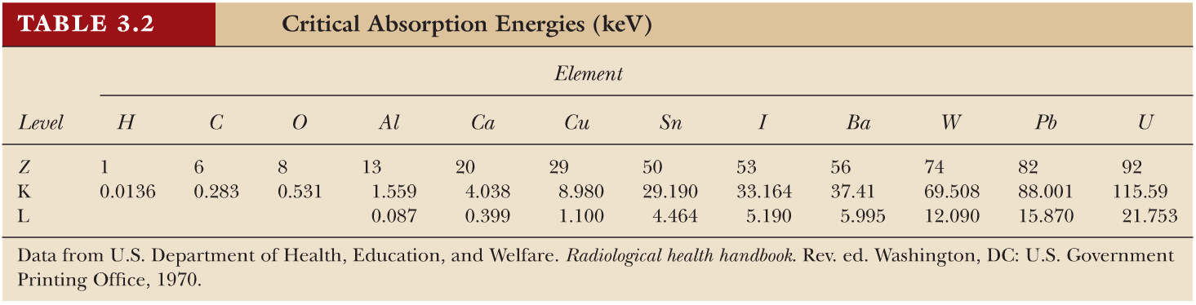
2. Ionization (Characteristic X-ray)
Critical absorption energy
- threshold energy that an incident electron must possess in order to first strip an electron from the atom

Slide 8
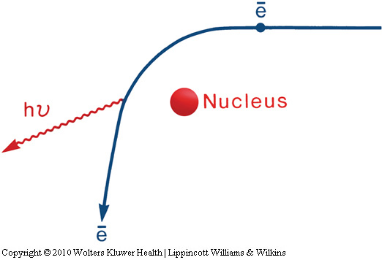
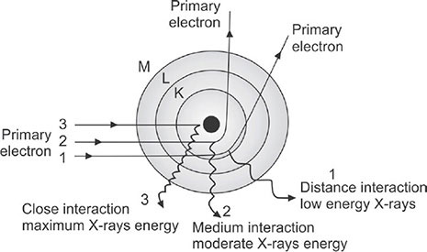
3. Bremsstrahlung radiaiton
result of radiative “collision”(interaction)
between a high-speed electron and a nucleus
High speed e + Nucleus: Coulomb Interaction
- Reduced speed of e
- Reduced kinetic energy of e
➔ electromagnetic radiation (continuous energy)
Maximum bremsstrahlung energy is initial energy of electron

Slide 9
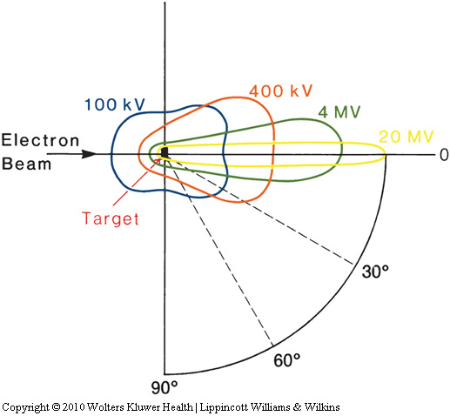
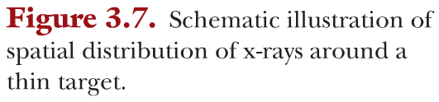
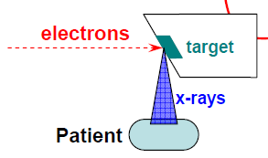
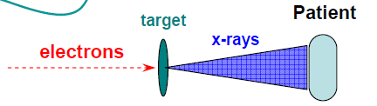
the direction of emission of bremsstrahlung photons depends on the energy of the incident electrons
Megavoltage x-ray tube: transmission type target
Low-voltage x-ray tube: reflection type target
For low energy x-ray
For high energy x-ray

Slide 10
the energy loss per atom by electrons depends on Z²
- probability of bremsstrahlung production ~ Z²
the efficiency of x-ray production: the ratio of output energy emitted as x-rays to the input energy deposited by electrons
Efficiency=9x10⁻¹⁰ZV, if Z=74, V=100kV → Efficiency=1%,
for high energy x-rays, it reaches 30~95% (6X→40%)

Slide 11
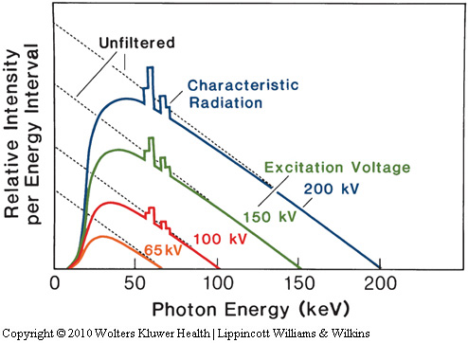
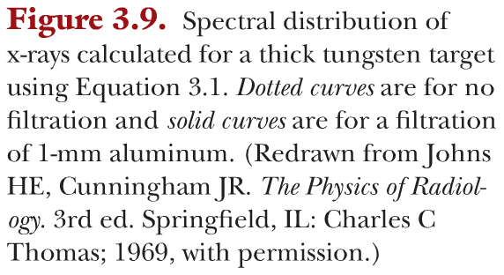
4. X-ray energy spectra
heterogeneous in energy
- continuous Bremsstrahlung + discrete characteristic
If no filtration, neither inherent nor added,
Kramer’s eqn, I_{E}=KZ(E_{m}-E)
max. photon energy E_{m} (in keV) = applied tube peak voltage (in kVp)

Slide 12
4. X-ray energy spectra
Inherent filtration: target, glass walls of the tube, thin beryllium window
- equivalent to 0.5 ~ 1.0 mm aluminum
Added filtration: Al or Cu, beam harden, improving the penetrating power
Increasing the voltage: improving the penetrating power
- combination of voltage and filtration
→ achieve desired hardening and acceptable intensity
The shape of the x-ray energy spectrum: the alternating voltage applied to the tube, multiple bremsstrahlung interactions within the target and filtration in the beam
- even if constant potential to tube, still be heterogeneous in energy because of the multiple bremsstrahlung
Difficult to characterize the beam quality in terms of energy, penetrating power, or degree of beam hardening
→ beam quality: average energy and half-value layer
- The average x-ray energy: 1/3 of the maximum energy or kV_{p}

Slide 13
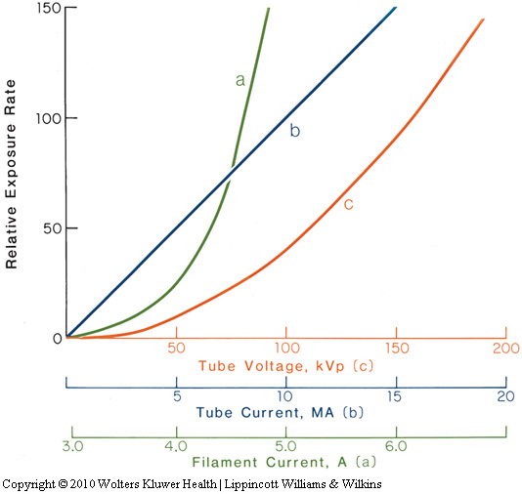
5. Operating characteristics
the relationships between x-ray output :
(a) filament current, (b) tube current, and (c) tube voltage
exponential increase.
Linear
c. square
Stable filament current is important for stable output.

Slide 14
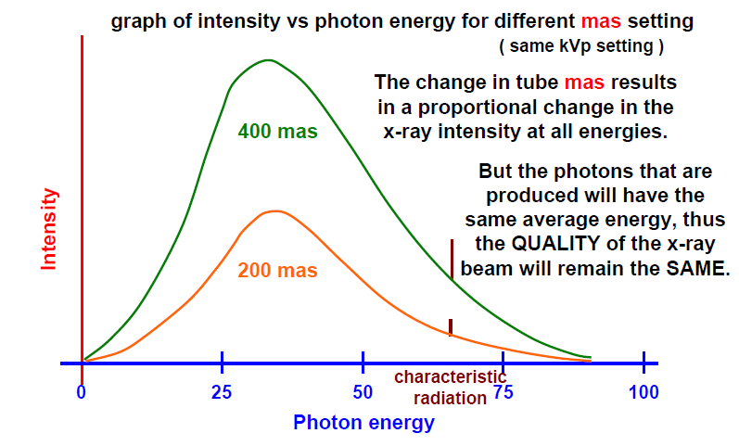
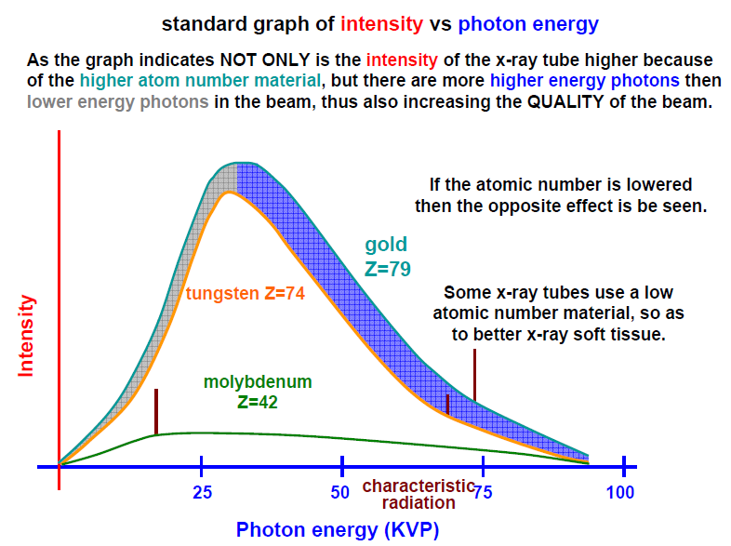
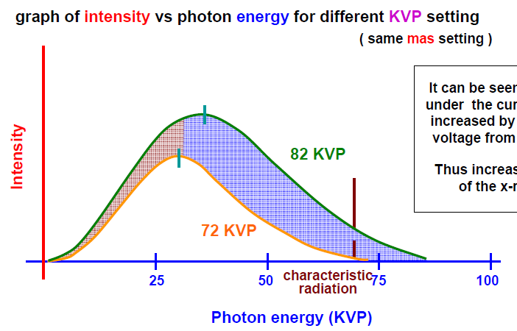
Intensity and energy spectrum
mAs: intensity of X-ray
kVp: intensity and energy spectrum
Target: depend on atomic number

Slide 15
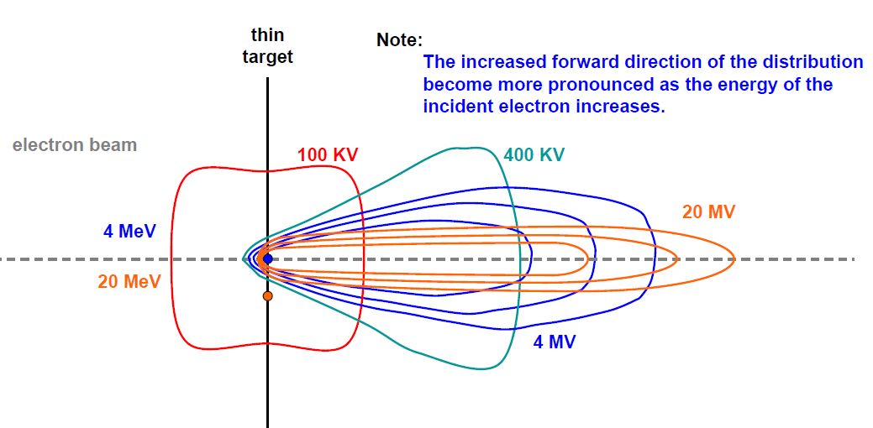
X-ray distribution around target
For low energy x-ray
For high energy x-ray

Slide 16
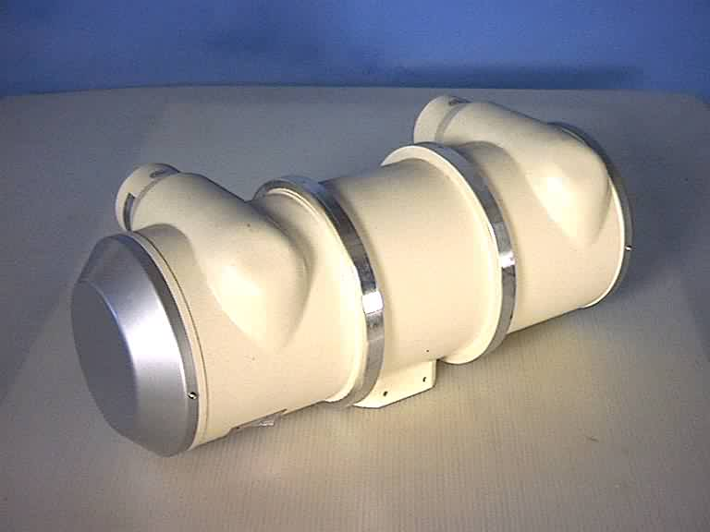
X-ray tube

Slide 17
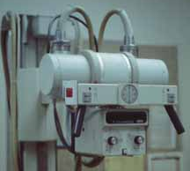
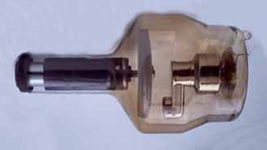
Housing
Visible part of tube
Glass Enclosure (insert)
Vacuum
Electrodes
Cathode
Filament
Anode
Target

Slide 18
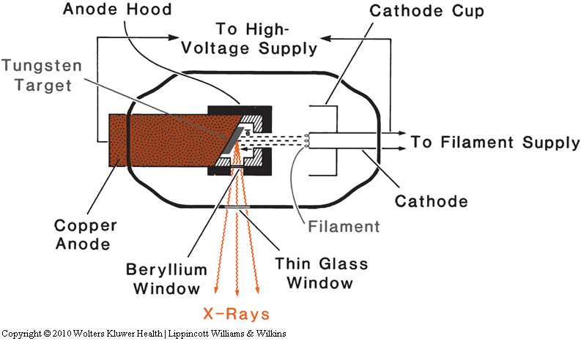
X-ray tube
Copper
(absorb secondary electrons)
Tungsten
(absorb x-ray produced
in the copper)
Thin beryllium windows to reduce inherent filtrations of the x-ray beam

Slide 19
X-ray tube
The anode
tungsten as the target material: high atomic number and high melting point
The efficiency of x-ray production depends on the atomic number:
Tungsten Z=74, a melting point of 3,370⁰C
efficient removal of heat from the target: a thick copper anode to the outside of the tube cooled by oil, water, or air, and rotating anodes
Function of the oil bath: 1. insulate the tube housing from high voltage,
2. absorb heat from the anode

Slide 20
X-ray tube
The anode
Anode hood (copper inside and tungsten shield outside) to prevent stray electrons from striking the walls or other non-target components of the tube
- Cooper: absorb the secondary electrons produced from the target
- Tungsten: absorb the unwanted x-rays produced in the copper
focal spot: as small as possible for producing sharp radiographic Images
smaller focal spots generate more heat per unit area of target and, therefore, limit currents and exposure.

Slide 21
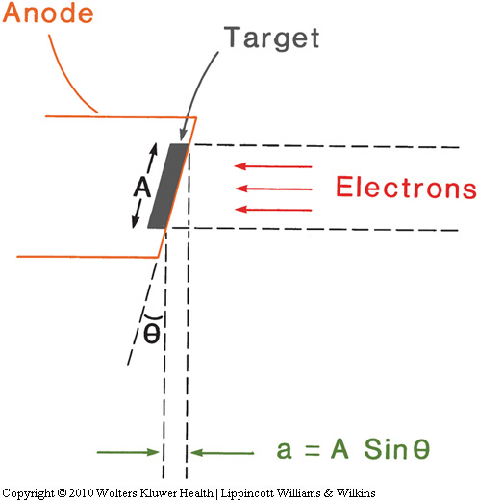
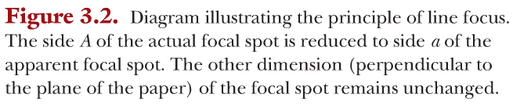
X-ray tube
principle of line focus
- apparent focal spot size
can be reduced by
the principle of
line focus
A side of actual focal spot
Apparent side

Slide 22
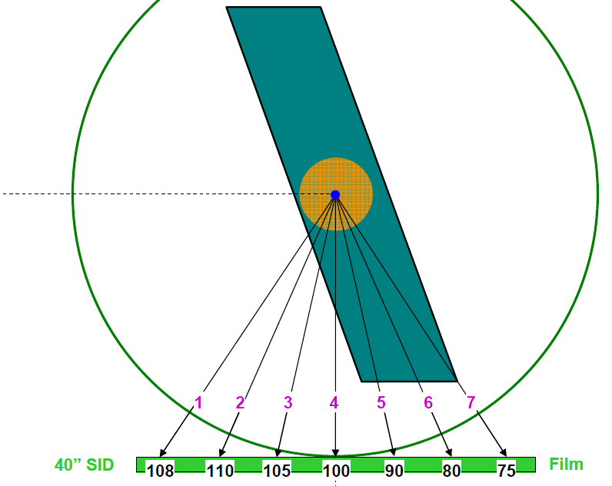
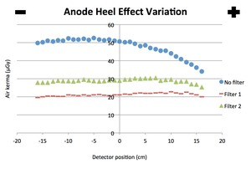
X-ray tube
In diagnostic radiology, the target angles small (6-17 degrees)
making focal spot sizes from 0.1x0.1 to 2x2 mm
In therapy tubes, the target angle large (about 30 degree)
making focal spot sizes from 5x5 to 7x7 mm
greater attenuation for x-rays coming from greater depths than those
from near the surface of the target : the heel effect → compensator used
Self attenuation

Slide 23
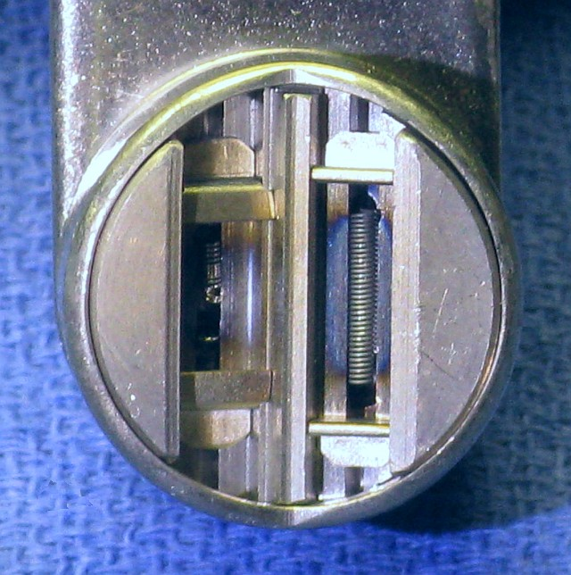
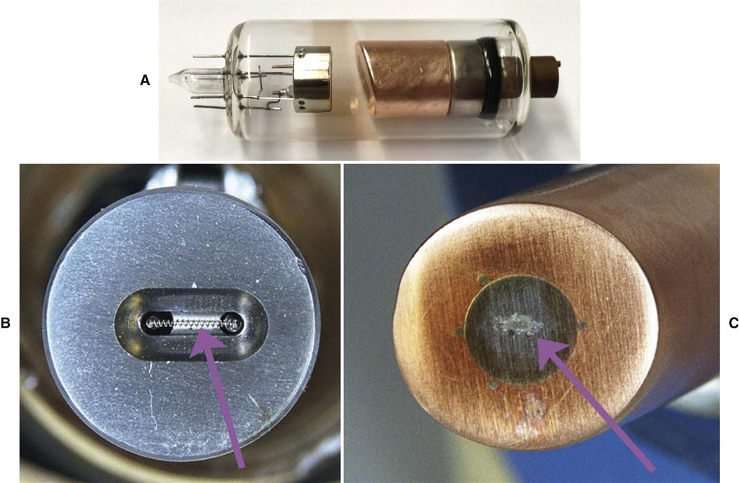
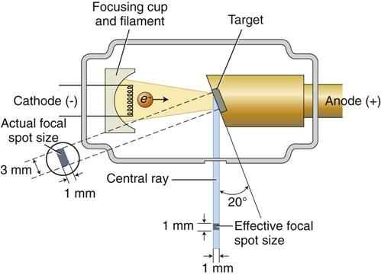
B. The cathode
wire filament and a negatively charged focusing cup (cathode cup)
- direct the electrons to strike the target in a well-defined area
the diagnostic tubes: two separate filaments to provide dual-focus
- focal spot size depends on filament size
- one provide small focal spot and the other large
filament material
- tungsten + 1~3% thorium (better emission of electrons)
- less tendency to vaporize

Slide 24
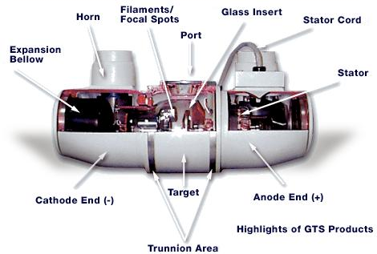
Inherent Filtration
Absorption of x-rays by tube
glass insert
insulating oil
housing window
Insulating Oil
Insert
Glass Window

Slide 25
Practical Filters
Aluminum
Most common
atomic # 13
inexpensive
copper
good for high kVp
sometimes used in combination with aluminum
aluminum absorbs copper’s 8 keV characteristic radiation
Aluminum Filter

Slide 26
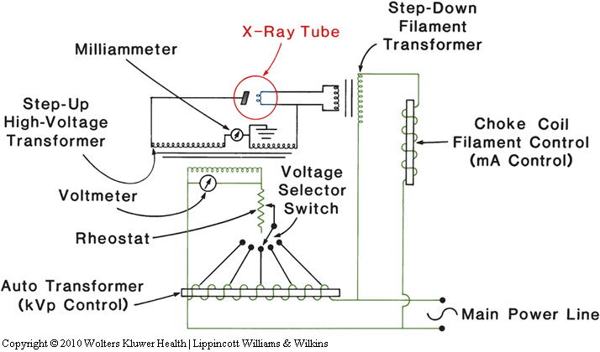
3.2. Basic X-ray circuit
high voltage circuit to provide the accelerating potential for the electrons and the low voltage circuit to supply heating current to the filament
filament temperature or filament current controls the tube current and hence the x-ray intensity
Low voltage circuit
- Filament supply 10 V at about 6 A.
- Step-down transformer

Slide 27
High voltage circuit
- Step-up transformer
- connected to autotransformer and rheostat
- Autotransformer: provide a stepwise adjustment in voltage
- Rheostat: variable resister
- appreciable power loss in rheostat whereas low in an inductance coil
Tube (peak) voltage measurement: sphere gap method
- two metallic spheres separated by an air gap
- relationship b.t. voltage, diameter of the spheres, distance at the instant that the spark first appears
Tube current can be read on a milliammeter placed at the midpoint of the x-ray transformer secondary coil which is grounded

Slide 28
Peak voltage and frequency
- if line voltage 220 V at 60 cycles / sec
→ peak voltage:
- if transformer turn ratio, 500:1 → peak voltage:

Slide 29
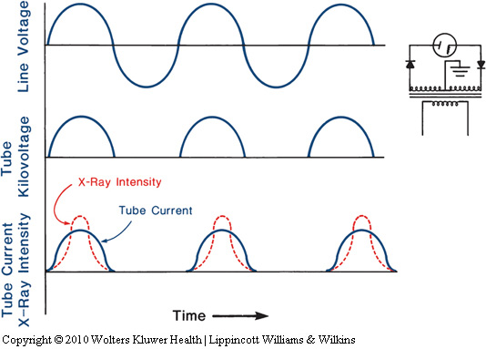
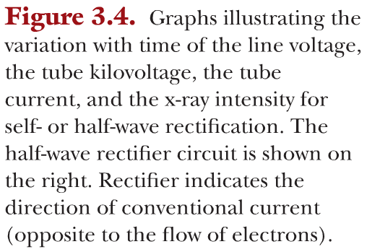
3.3. Voltage rectification
no x-rays during the inverse voltage cycle for self-rectified circuit (an inverse electron current destroyed the filament)
solved by using voltage rectifiers.
Half-wave rectification

Slide 30
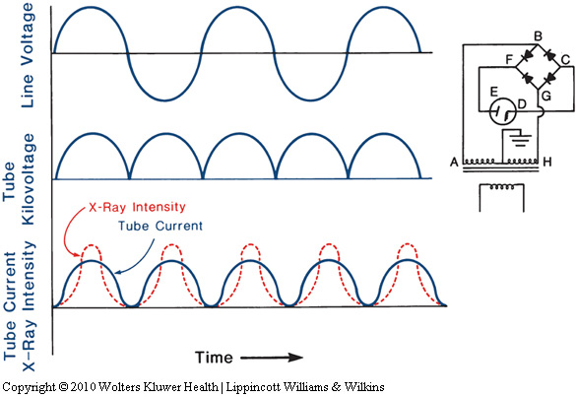
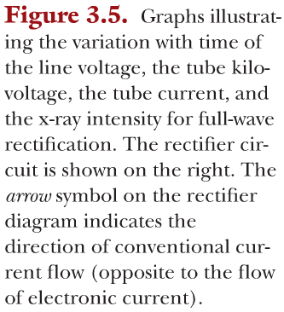
Full-wave rectification
- electron for negative A: ABCDEFGH
- electron for positive A: HGCDEFBA
Smoothing condenser: keep nearly constant tube voltage

Slide 31
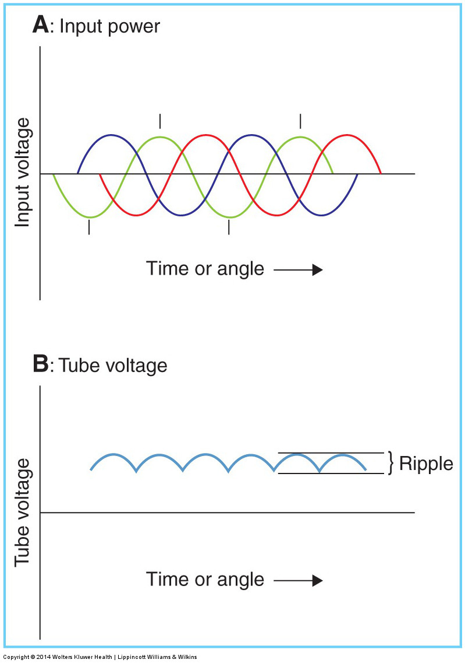
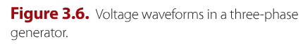
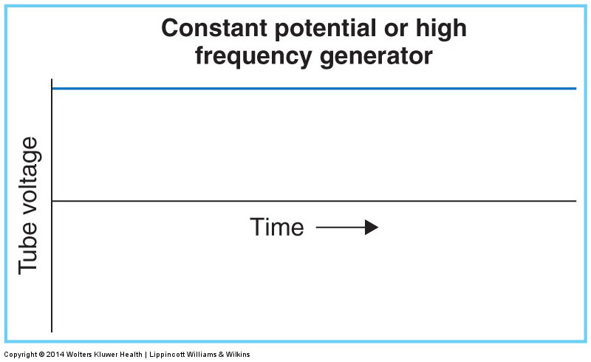
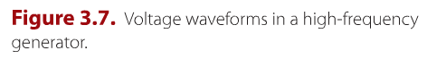
3.4. High-output X-ray Generators
A. Three-phase generators
3 phase power + full-wave rectification
→ 6 voltage pulses during each power cycle
- Voltage ripple: 13% ~ 25%
- Slight delay in phase b.t. waveforms → reduce ripple to 3% ~ 10%
B. Constant potential Generators
3-phase line voltage coupled directly to the high-voltage transformer
- ripple of less than 2%
→ high x-ray output per mAs, expensive
C. High-frequency Generators
State of the art generator
DC → high Freq. low Volt. AC → high Volt. AC

Slide 32
Clinical Radiation Generators
Chapter
4
March, 2020
Ui-Jung Hwang, PhD, KBMP, DABR
Chungnam National University Hospital

Slide 33
Accelerators
Quality of X-ray depends on the applied Voltage ( Beam penetration )
Kilovoltage Unit:
- 20 kV: Grenz-Ray therapy (no longer used in RT)
- 40-50 kV: Contact therapy (SSD 2 cm)
- 50-150 kV: Superficial therapy (SSD 15-20 cm)
- 150-500 kV: Orthovoltage therapy
- 500 –1000 kV: Supervoltage therapy
Megavoltage Unit: > 1 MV
ex: Van de Graaff generator,
Linear accelerator,
betatron
microtron,
Cyclotron, Synchrotron
teletherapy γ-ray unit ( Co 60)
Electrostatic field type
(KE of the particle can not be larger then the applied potential E)
Cyclic type
Non conservative E field, but can produce charged particles of much higher KE than electrostatic accelerators.
→ uses variable EM field.
- Particles are made to follow a closed path of E(with M) field many times, then the KE >PE can be obtained.

Slide 34
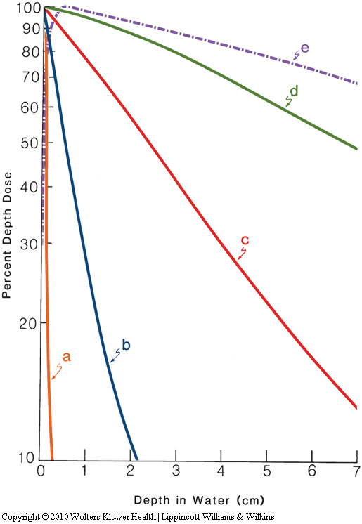
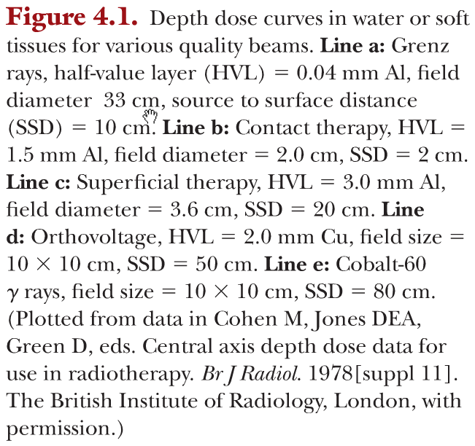
Depth Dose Characteristics of X-rays
build up region
a: Grenz-ray Therapy
b: Contact therapy
c: Superficial therapy
d: Orthovoltage therapy
e: Co-60

Slide 35
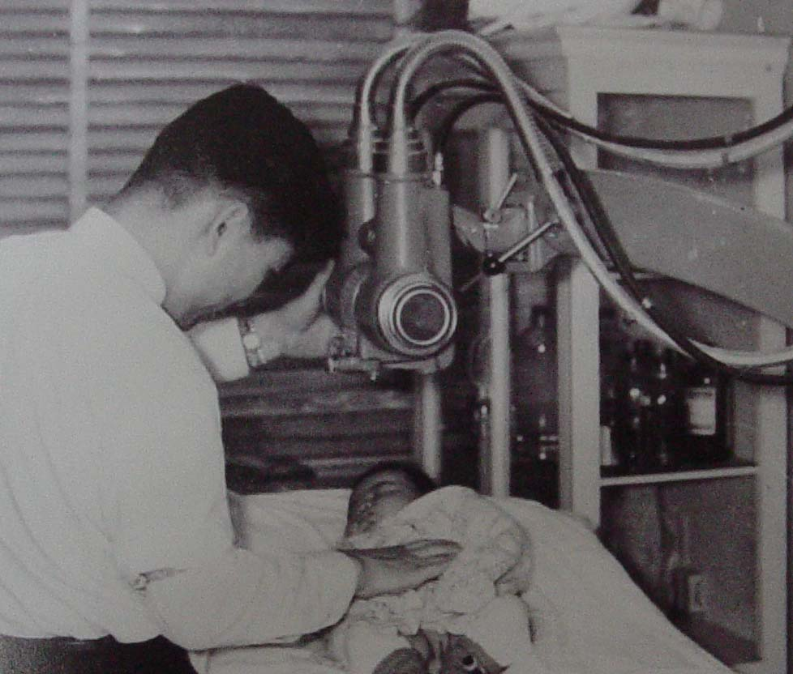
120 kVp - 원자력병원

Slide 36
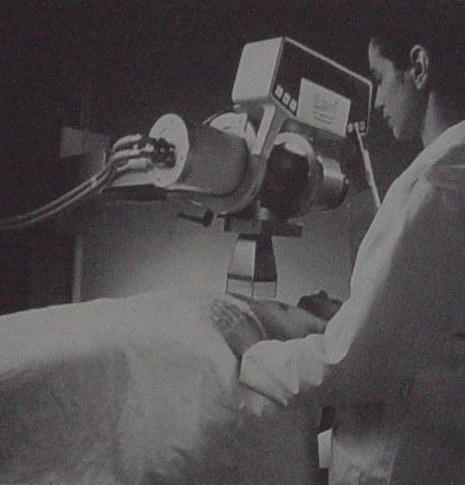
Orthovoltage x-ray unit (200-300 kV)

Slide 37
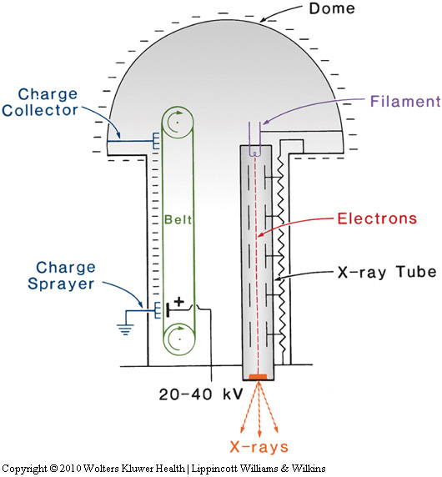
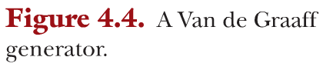
4.2. Van de Graaff generator
- typically 2 MV ( ~10 MV)
- 20 ~ 40 kV is applied across a moving belt
- corona discharge and spread electrons to the belt
- Insulation by N₂ and Co₂ gas of 20 atm
- no longer used because of
emergence better machines such as Co-60 unit and LINAC

Slide 38
Betatron
Developed in 1940 by D.W. Kerst as a cyclic electron accelerator for basic physics research.
Consists of a magnet fed by an AC of 50-200Hz.
Electrons are made to circulate in a toroidal vacuum chamber which is placed into the gap bw two magnet poles.
electrons are accelerated by the E field, which is induced in the donut by the changing magnetic flux in the magnet.
1950’s betatron plays an important role in MV RT.
Linac is superior to betatron
- higher output, larger FS, more compact design, quieter operation EXCEPT the lower cost for e beam
Only used to accelerate electrons.

Slide 39
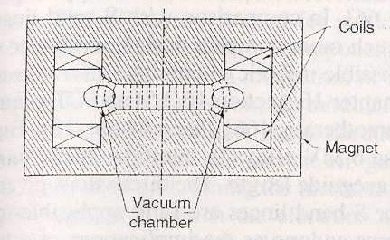
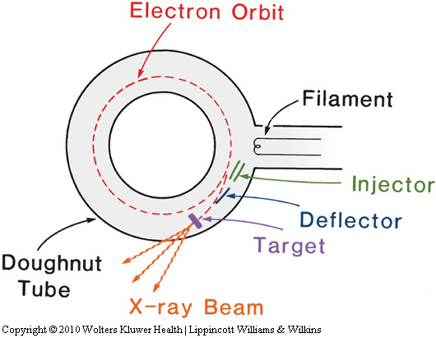
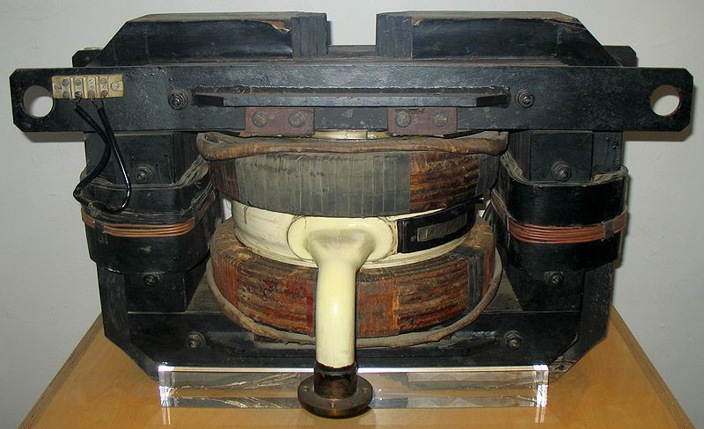
Betatron

Slide 40
Cyclotron
Developed in 1930 by E.O. Lawrence for acceleration of ions (protons, deutrons, heavier ions) to a KE of a few MeV.
Developed for basic research of physics, but found to be useful for radiotherapy with proton and neutron beams.
Particles are accelerated along a spiral trajectory guided inside two evacuated half-cylindrical electrodes (dees) by a uniform magnetic field ( ~1T).
With constant frequency (10-30MHz) voltage is applied bw the two electrodes.→ charged particles are accelerated while crossing the gap bw the electrodes.
Can not be used for electron because of the increased relativistic effects. ( V is not constant & not in phase with RF fields)

Slide 41
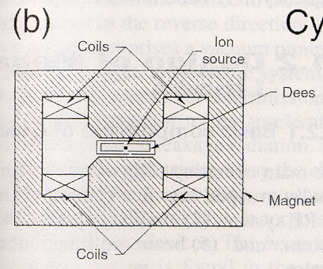


Cyclotron

Slide 42



Slide 43
Microtron
Electron accelerator : combined feature of linac &cyclotron.
Developed in 1944 by V.I. Veksler. Used contemporary photon & electron radiotherapy.
Two types: circular & racetrack.
Circular: electrons gain energy from a microwave resonant cavity and describes circular orbit with increasing radius in uniform magnetic field.
Advantage of microtron over linac:
- smaller beam divergency
- less energy spread in the electron beam spectrum.
Simplifies the beam transport from vacumm chamber to the x-ray target and facilitates the use of multiple beamlines.
Several treatment rooms can be designed to share one microtron

Slide 44



Microtron

Slide 45
Synchrotron
Like betatron, charged particles follow a circular orbit of constant radius in the form of donut.
The donut is placed into a magnetic field that changes in time to account for the increase in particle mass with energy.
The particles are accelerated by an RF electric field localized at a certain point.
~ MHz for protons, ~100 MHz for electrons.
Mainly used for high energy particle physics research, but are also used as source for proton beam radiotherapy.
Need auxiliary accelerator as a injector.

Slide 46

Synchrotron

Slide 47


Slide 48
Linear Accelerators

Slide 49
Historical development of Linacs.
Linac development: More gradual
1935-1945: the development and basic theoretical understanding of microwave device was achieved through the invention of microwave cavities and microwave power sources(microtron & klystron).
1945-1960: various physics research groups built linacs.
– W.W. Hansen’s group ( Stanford Uni.USA)
- D.D. Fry’s group (TRE in England)
1947 : Stanford: 4.5 MeV electron energy
TRE: 3.5 MeV electron energy

Slide 50
1952, Ginzton, Hansen, and Chodorow ( Stanford Univ.) built a 30 MW klystron. → High energy linac & very compact linac in the 10-25 MeV energy range.
The first clinical linac: early 1950’s. Hammersmith hospital in London ( England) – 8MV x-ray beam with 2MW magnetron
5 MV linac using 1 MW klystron was built and installed in Stanford & treated the first patient in January 1956
Varian : The first North American company to build a commercial medical linac. 1962 built the first prototype fo 6MV isocentric linac. Now x-ray energy 4-25 MV

Slide 51
Basic description of medical linacs
Cyclic accelerator which accelerate electrons to kinetic E from 4 to 25 MeV
Using non-conservative microwave RF
- frequency range: 10³.MHz( L band) to 10⁴ MHz(X band)
- vast majority running at 2586 MHz( S band).
Electrons are accelerate following straight trajectory ( accelerating waveguides)
High power RF field are produced through the decelerating electrons in retarding potentials in magnetron and klystron.

Slide 53
5 Generation of Linacs.
Low-energy photons(4-8 MV)
Straight-through beam; fixed flattening filter; external wedges; symmetric jaws; single transmission ionization chamber; isocentric mounting
2) Medium-energy photons (10-15 MV) and electrons
Bent beam; movable target and flattening filter; dual transmission ionization chamber; electron cones
3) High-energy photons (18-25 MV) and electrons
Dual photon energy and multiple electron energies; achromatic bending magnet; dual scattering foils or scanned electron pencil beam; automatic wedge selector; independent collimator jaws

Slide 54




4) High energy photons and electrons.
Computer-controlled operation; dynamic wedge; electronic portal imaging device; multileaf collimator.
5) High energy photons and electrons
Photon beam intensity modulation with MLC. Full dynamic conformal dose delivery with intensity modulated beam produced with an MLC
Linac: Choice of S band-the most practical compromise bw the required accelerating waveguide dimensions and dimensional tolerances governed by the manufacturing process and thermal expansion during operation.
X-band ( 10⁴ MHz) linac: cyberknife (9300 MHz)
S band: Tomotherapy (3GHz)

Slide 55
Design of Megavoltage Linacs
Basic component
Injection system: source of electron-electron gun
RF system: that used for particle acceleration
- RF power source ( magnetron or RF driver with klystron)
- Modulator: generation of high power & short duration of pulse.
- control unit: timing the modulator
- Wave guide
- Circulator: allow the propagation of RF power (prohibit of reverse direction)

Slide 56
3) auxiliary system: vacuum pumping system, water cooling system, air pressure system, gas dielectric system for transmission of microwaves from the RF generator to wave guide. Shielding.
4) beam transport system transporting electron beam from waveguide to target/scattering foil, magnetic steering, focusing device.
5) Beam collimation and monitoring system located in the treatment head, provide shaping manipulating & monitoring of the x-ray/e beams.

Slide 57


Linear accelerator

Slide 58

Linear accelerator

Slide 59
Power supply provides DC power to the modulator,
- which includes the pulse-forming network and a switch tube known as hydrogen thyratron
Flat-topped high voltage DC pulse of a few microseconds in duration from the modulator
These pulses are delivered to the magnetron or klystron and simultaneously to the electron gun
Pulsed microwaves produced in the magnetron or klystron are injected into the accelerator tube via waveguide system
At the proper instant, electrons, produced by an electron gun, are pulse injected into the accelerator structure
Initial energy of electrons injected into: ~ 50 keV
High-energy electrons from the exit window: in the form of a pencil beam of about 3 mm in diameter

Slide 60


RF power generation (Magnetron vs klystron)
A. Magnetron
Produces microwave pulse of 3 GHz, microsecond duration, several hundred pulses per second repetition
Vacuum diode tube with a cylindrical cathode surrounded with an anode. - symmetrical array of resonant cavities.
Cavities oscillate in the fundamental mode( determined by the design dimension)
Whole device immersed in a uniform magnetic field provided by poles of permanent magnet (static B-field + pulsed DC E-field)
electron from cathode → accelerated to anode.
Cavity → acceleration&deceleration → 60% of KE to microwave power
Peak power → electron emission & Voltage b.t. cathode &anode.
typically 2 MW (for 6 MV or less Linac)
Max. 5 MW (for 25 MeV Linac)

Slide 61


Magnetron

Slide 62




Magnetron

Slide 63

Klystron
Not a generator of microwaves but rather a microwave amplifier
Driven by low-power microwave oscillator
Velocity modulation to form electron bunching through drift tube
- electron acceleration & deceleration
Max power 7 MW or higher
Electrons are accelerated toward ground cavity (- Voltage pulse applied).
pulse from the modulator accelerate electrons pass through two resonant cavities.
- buncher cavity: excited by low-power oscillator (Rf driver)
- catcher cavity: emit high power RF

Slide 64

Klystron

Slide 65


Klystron

Slide 66
Magnetron vs Klystron
Magentron
- smaller in size , no RF driver, with lower voltage, lower price.
- less stable, low power
Klystron
- Generally used for high E, > 5MW
- Bulky, need higher voltage, need RF driver, should be in a insulating oil tank

Slide 67

Thyratron
Used to switch high voltage on and off very quickly
Important components of the pulse modulator, pulse forming network (PFN)
- That generates short pulses to both gun and klystron or magnetron
Typical pulse is 50 kV with 4 μs duration
Field with gas (hydrogen) for high speed switching, low pressure ~0.5 torr

Slide 68



Thyratron
No current between cathode and anode in OFF state
By applying positive voltage to the control grid, plasma created at the grid and quickly drifts to the provide conduction path from cathode to anode, ON state
“Hot thyratron” as a heater to make ionization much easier and the Grid more sensitive
Once turned on, it remains conducting as long as there is current flowing
When anode voltage or the current falls to zero, it switches off

Slide 69

Linac Pulse
Pulses from thyratron ~ 4 μs, sent simultaneously to both gun and klystron (or magnetron)
- give current to gun and power to wave guide → radiation
Electron bunch up inside the wave guide: resonant freq. (3 GHz for S-band → 0.3 ns)
Train of bunches of electrons is generated as long as the pulse from the thyratron is on (radiation pulse ~ 4 μs)
Pulse repetition frequency (PRF) ~ 250 Hz
→ interval between consecutive pulses ~ 4 ms long
→ duty cycle ~ 0.1%
(thyratron pulse duration)
For 300 mu/min
- beam current for photon ~ 100 mA (peak current during one pulse)
- beam current for electron ~ 1 mA
← low efficiency of e to X conversion
← beam attenuation in the target and filter
(PRF, 250 Hz)
(S-band, 3 GHz)

Slide 70
C. Linac x-ray beam
Bremsstrahlung x-rays
Target is water cooled and thick enough to absorb most of the incident electrons
Electron energy is converted into a spectrum of x-ray energy
E_{max} (MV) = E_{ins. Elec} (MeV)
Average photon energy, E_{ave} ~ 1/3 of E_{max}
Electron beam → MeV
- because it is almost monoenergetic beam
Photon beam → MV
- because heterogeneous in energy, as if tube voltage

Slide 71
D. Electron beam
Narrow pencil beam about 3 mm in diameter
Strike an electron scattering foil (usually lead) to spread the beam,
Uniform electron fluence across the treatment field
Thickness → most electrons are scattered instead of suffering bremsstrahlung
Small fraction is still converted into bremsstrahlung → x-ray contamination of the electron beam
Photon contamination: scattering foil, collimator walls or other high-Z materials in beam pass
E. Treatment head
Thick shell of high density shielding material such as lead, tungsten, or lead-tungsten alloy
Shielding against leakage radiation in accordance with radiation protection guidelines

Slide 72


F. Target and flattening filter
Flattening filter to make intensity uniform across the field
Usually lead, although tungsten, uranium, steel, aluminum, or a combination of them

Slide 73
G. Beam collimation and monitoring
Fixed primary collimator
flattening filter (or scattering foil)
dose monitoring chambers
- several ion chambers or a single chamber with multiple plates
- Usually transmission type (flat parallel plate chambers), but cylindrical thimble chambers in some linac
- Monitor dose rate, integrated dose, field symmetry
- Ion collection efficiency must remains unchanged with dose rate change
- Bias voltage 300 ~ 1000 V
- Usually sealed chamber not to influenced by temp. and air pressure of outside air
- Should be periodically checked for leaks

Slide 74
X-ray collimator system
- movable jaws (lead or tungsten blocks)
- Move so that the block edge is always along a radial line passing through the target
Field size definition is provided by a light localizing system
Electron collimation system
- electrons scatter readily in air → must be achieved close to the skin surface of the patient
- scattering of electrons from the collimator surfaces and movable jaws
- Dose rate can change by factor of 2 or 3 as jaws are fully opened
- Output critically depends on the surface area of the collimator
→ wide open jaws + auxiliary collimator (as trimmers, sometimes cones) down to the skin surface
H. Gantry
Isocenter: the point of intersection of the collimator axis and the axis of gantry rotation
Isocentric treatment

Slide 75
Properties of waveguide
Evacuated/gas filled metallic structure used in transmission of microwaves.
Propagation-Maxwell’s eqs & boundary condition at the wall : Et=0, Hn=0
Uniform waveguide: simple cylindrical metal tube-can not be used for electron acceleration in a linac. ( v_{ph}>C)
Loaded wave guide: uniform wave guide+periodic perturbation to make v_{ph}<C & enable the electron to follow the electric field pattern.
- Exist a series of cavities: s-band (2856 MHz) cavity size=10cm diameter, 2.5-5cm in length.
- purpose of cavities:* to couple & distribute micro-power * to provide a suitable E pattern with Vph<C

Slide 76

Traveling electric field pattern & charge distribution (a) for a uniform waveguide (b)disk-loaded waveguide

Slide 77



Traveling wave structure
1) Traveling wave: microwave enter @ gun side. Propagate to the high E end- absorbed without any reflection OR exit the waveguide

Slide 78


Slide 79


2)Standing wave
Both ends is terminated with a conducting disk to reflect the micropower with π/2 phase change.->build up standing wave.
No electric field in the coupling cavity only for coupling→ effectively shortening the length of the waveguide.

Slide 80



Slide 81
RF power can be supplied at any convenient point.
Side coupling cavity can shorten the waveguide length
E field in the guide is constant in the standing wg, but E field is attenuated in a traveling wg.
For a given microwave peak power level (typical 2.5 MW)
standing wave structure > higher electron energy / length
20 MeV/m 5MeV/m
Need more mean RF power (25%) in standing WG.

Slide 82

Bending magnet

Slide 83

Bending magnet
X-ray target
Focusing
and
steering
magnets

Slide 84


Slide 85


carousel
ionization chambers

Slide 86

Accelerating wave guide
Length: ~30cm for 4MeV, ~150cm at 25 MeV
4-6MeV: No wave beam transport, no electron therapy option.

Slide 87


Wave guide for electron energy 8-15 MeV( intermediate energy), 15-30 MeV ( high energy)

Slide 88
Energy is determined by amount of RF power and number of electrons injected. This ratio must be correct in order to pass through bend magnet energy slits.
Bend Magnet Shunt current and fixed +/- 3% Energy Slits pass only electrons of proper energy. The electrons outside this window strike the energy slits and are converted to heat.

Slide 89






Halcyon
Unity
MRIDIAN (ViewRay)
Theratron (Co-60)

Slide 90

Flattening filter
Pb for Low E
Pb or W up to 15 MeV
Fe and Pb core for 20~25 MeV
Al or Fe for higher E

Slide 91

Flattening filter
Flattened beams
Make dose calculation for simple algorithms easier
So much head scatter
→ output factor can vary with FS
FFF beams
Cyber knife, Tomotherapy, …
Most useful for small field techniques (SBRT, IMRT, …)
A softer energy spectrum
Higher photon energy fluence, higher dose per pulse
Reduced electron contamination to the beam
Reduced head scatter (head leakage 50%)
Higher dose rate → decrease treatment time
Reduced sensitivity to beam positioning and energy variations
Potentially increased dose calculation accuracy
← reduced output factor variations
← reduced e-contamination
← reduced leaf transmission

Slide 92


Flattening filter
Flattened beam
FFF beam
Relative constant energy spectrum across the profile
→ Almost constant profile with depth
Similar d_{max} across the profile
- Reduced e-contamination → move d_{max} deeper
- Softer spectrum → move d_{max} shallower

Slide 93




Note)
Bowtie Filter in CT
Human body anatomy typically has a round cross section
- thicker in the middle than in the periphery.
to reduce the beam intensity at the periphery of the beam
- corresponding to the thinner areas of a patient’s anatomy.
Because of their shape they are often referred to as bowtie filters.
Bowtie filter (Al) for Varian OBI
Full fan
Half fan

Slide 94
Flatness and Symmetry
Flatness and Symmetry: adjusted by changing position or angle of e-beam to the target
Position and angle: by varying the current through the steering coils

Slide 95

Flatness and Symmetry
Radial angle coil primarily adjusts inplane profile
Transverse angle coil primarily adjusts crossplane profile
Buncher coils format and focus e-packets at the beginning of the accelerator guide

Slide 96


